Slide 1
My last PPT for you ☺

Slide 2

Stay curious, work hard, dream big!
Breathe!
Use every moment to improve yourself and things around you
You can learn from anything and everything, including your own enemy

Slide 3
Statistics is an important topic
It is used (AND misused) worldwide in every topic
Don’t be the ones misusing it
Hopefully, after having taken this course, you will be USING it ☺
Statistics is beautiful, you can do wonders with this tool

Slide 4
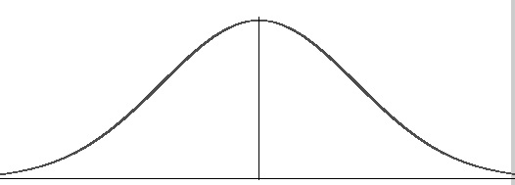
This world is like a normal distribution, with different kind of people and some being outliers.
We can keep striving towards shifting the mean of this normal distribution to make this world a better place to live
Do your bit to shift the mean ;)
Goodness

Slide 5

My office is FRNY 1121
Stop by any time!
I would love to connect with you after this course
I love you all!
All the very best for your future endeavors

